Slide 1
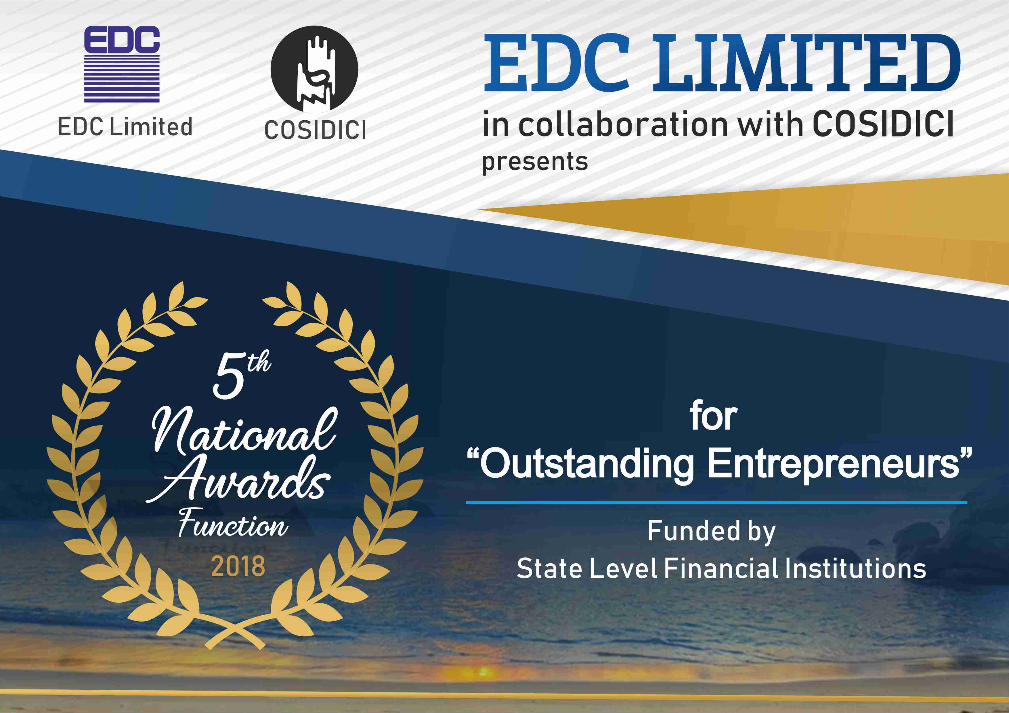

Slide 2
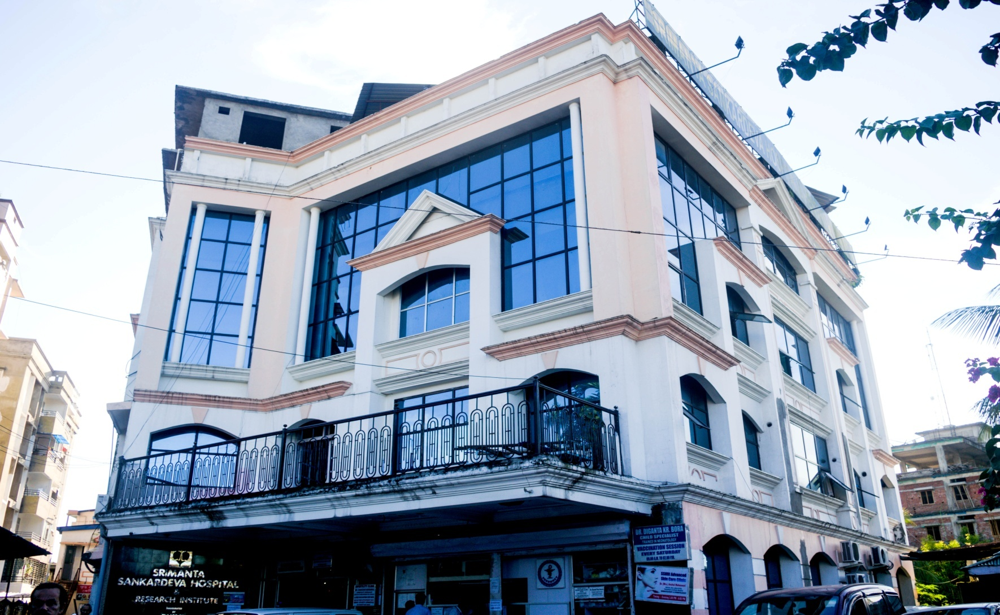
Assam Financial Corporation {AFC}, Guwahati
M/s Basils India Pvt. Ltd.

Slide 3
Assam Financial Corporation {AFC}, Guwahati
M/s Basils India Pvt. Ltd.
Mrs. Kanchan Dubey Mahanta, started M/S Basils India Private Ltd. In Dibrugarh, Assam in the year 2000 with three other Directors. In the year 2003 she established Srimanta Sankardeva Hospital And Research Institute with super speciality services not available in the city at that time in Dibrugarh.
For further expansion Mrs Mahanta took financial assistance from Assam Financial corporation five years ago to establish 3 major super speciality departments like Neurosurgery ,Nephrology and Urology. The hospital also provides 24/7 services for accident and trauma care, Dialysis etc. It is accredited with NABH (entry level) and ISO 9001:2015 certification for quality services and EQAS certification from Apollo Hospital , Chennai. Its future plans are to expand the capacity from 70 beds to 100 beds by June 2018.

Slide 4
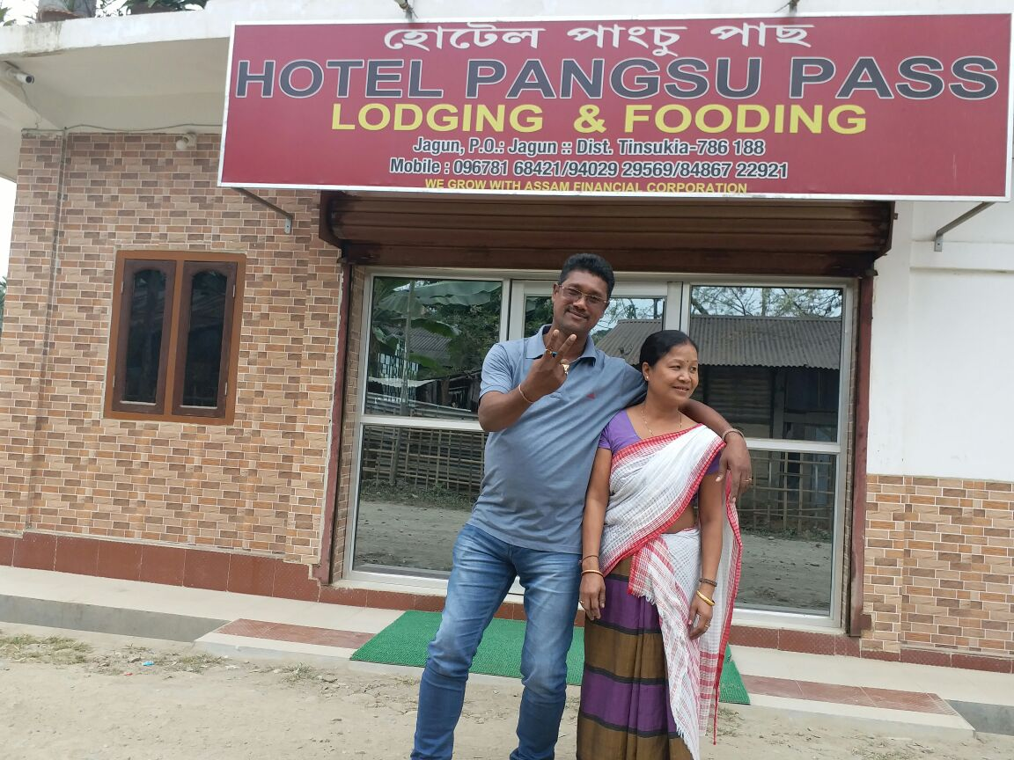
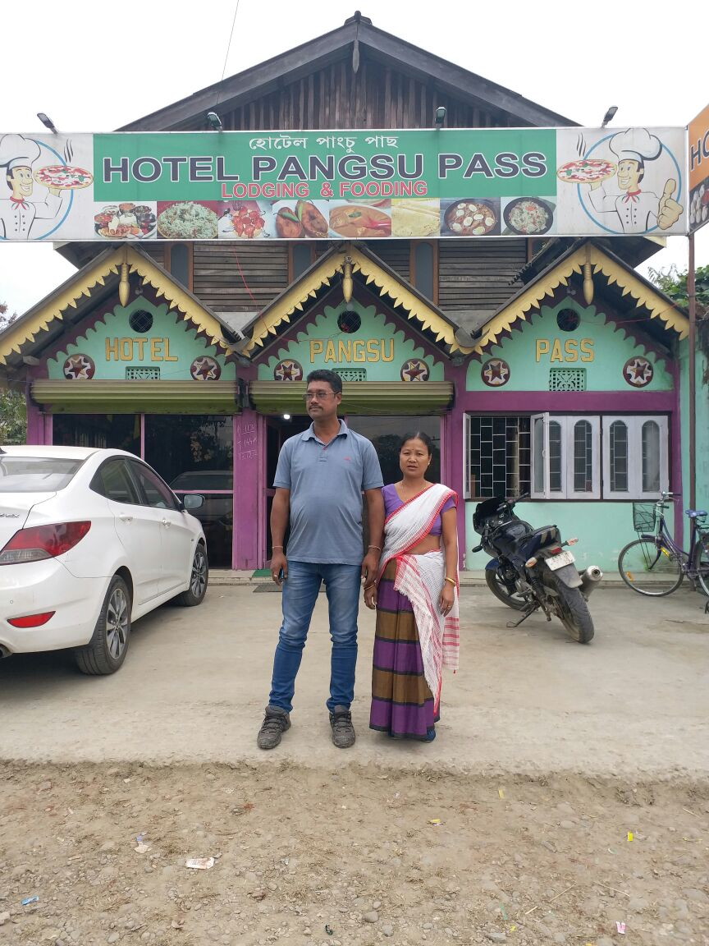
Assam Financial Corporation {AFC}, Guwahati
M/s Hotel Pangsu Pass
Smt. Mina Tayeng Chetia

Slide 5
Assam Financial Corporation {AFC}, Guwahati
M/s Hotel Pangsu Pass
M/s Hotel Pangsu Pass was established by Smt. Mina Tayeng Chetia with financial assistance from AFC. The Hotel enjoys a good reputation in the market and is very prompt in its repayment .

Slide 6
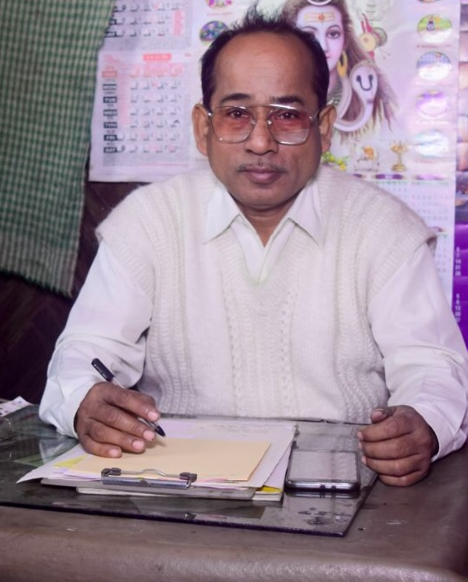
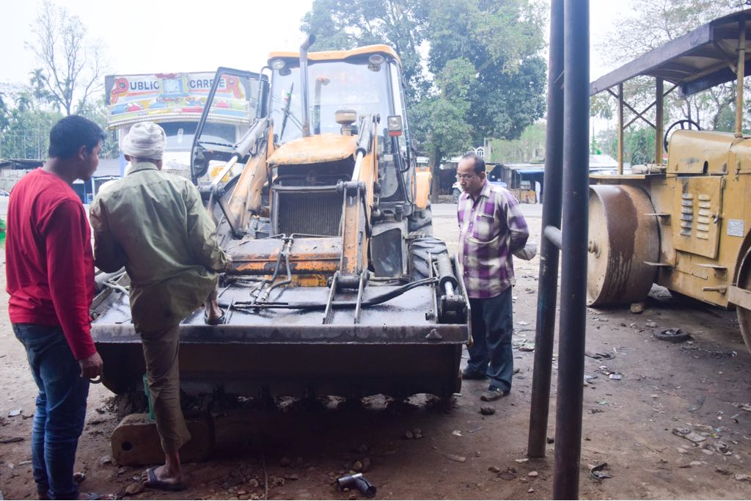
Assam Financial Corporation {AFC}, Guwahati
M/S Boruah Automobiles
Shri Dhormeswar Boruah

Slide 7
Assam Financial Corporation {AFC}, Guwahati
M/S Boruah Automobiles
M/s Boruah Automobiles established by Shri Dhormeswar Boruah in the year 1992 with financial assistance from AFC is involved in the activity of automobile servicing. The unit has now diversified into manufacture of Hydraulic Tractor Trolly. It enjoys a good reputation in the market and is prompt in its repayment .

Slide 8
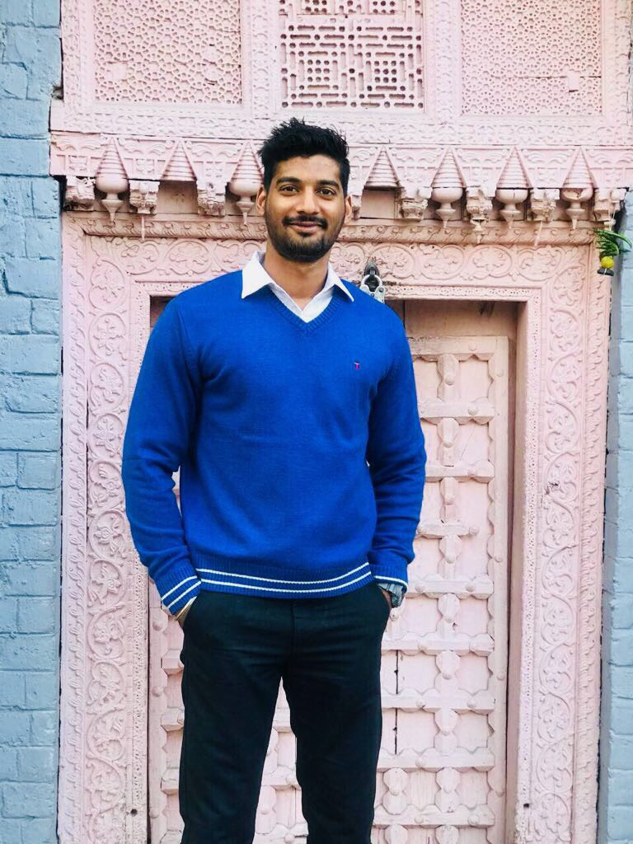
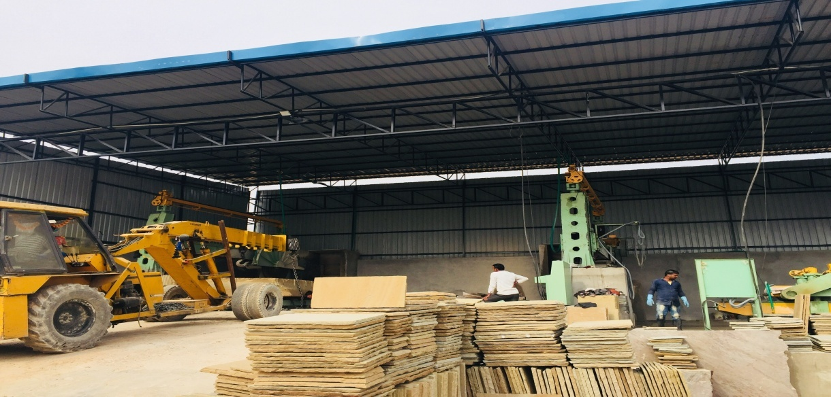
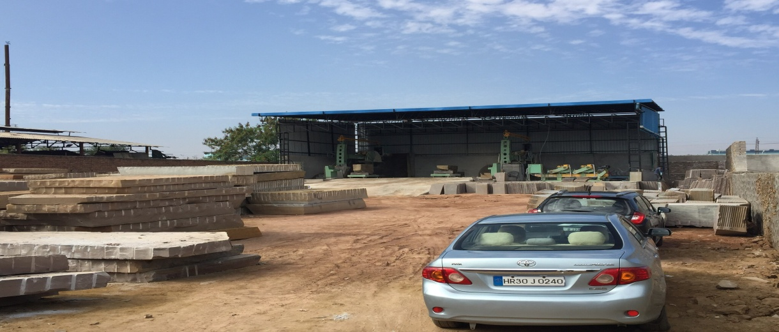
Rajasthan Financial Corporation {RFC}, Jaipur
M/s Pandit Stone Industries
Shri Raja Pandit

Slide 9
Rajasthan Financial Corporation {RFC}, Jaipur
M/s Pandit Stone Industries
Established by Shri Raja Pandit with financial assistance from RFC M/s Pandit Stone Industries Kota works with Natural Stone. The factory is equipped with block cutters, calibration machine, cutting and polishing machines to give the desired traditional or contemporary look to various natural stones for indoor and outdoor landscaping projects. It produces finest quality natural stones to meet the ever increasing demand from the European and North American Markets .

Slide 10
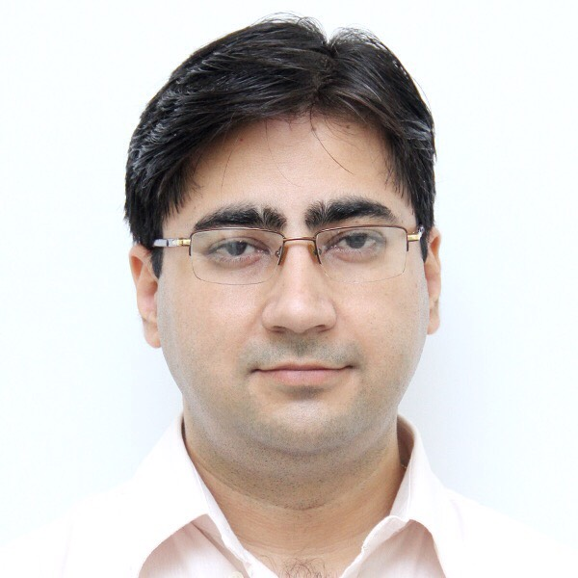
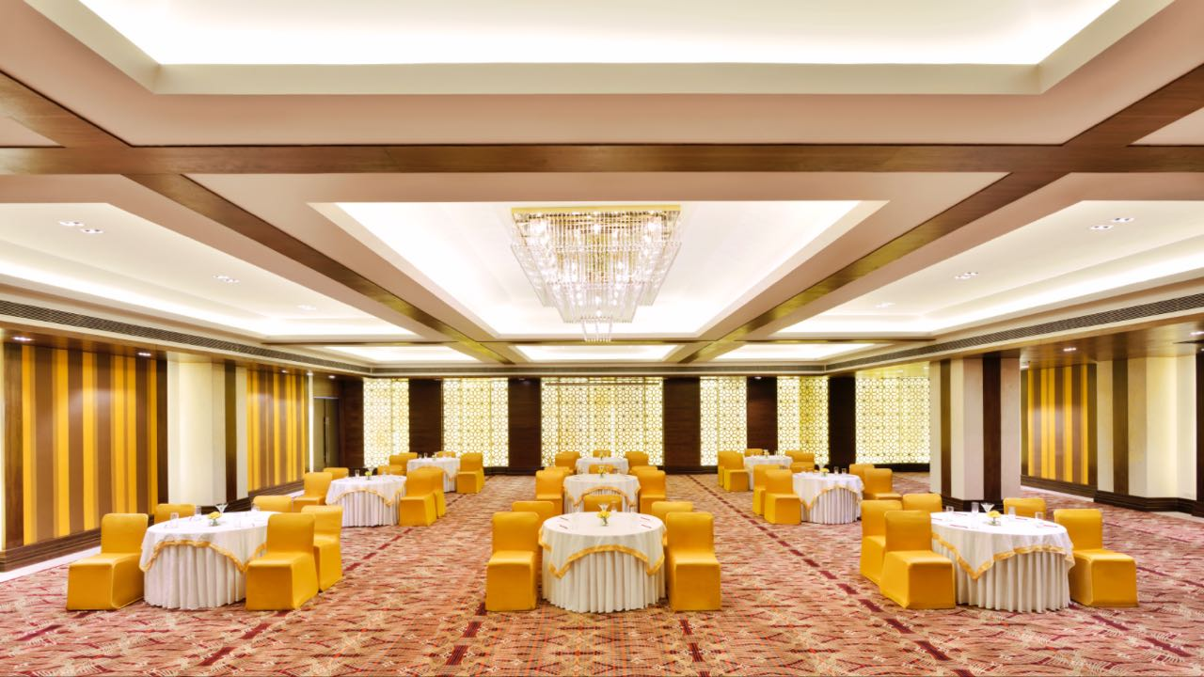
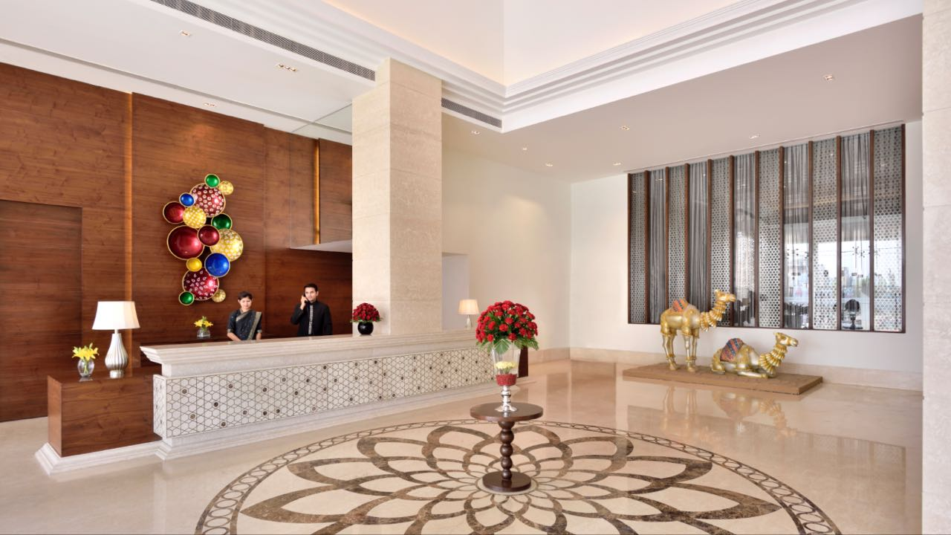
Rajasthan Financial Corporation {RFC}, Jaipur
M/s Malkera Hotels And Resorts Pvt. Ltd.
Shri Priyavrat Pal Singh

Slide 11
Rajasthan Financial Corporation {RFC}, Jaipur
M/s Malkera Hotels And Resorts Pvt. Ltd.
Shri Priyavrat Pal Singh conceptualised the Luxury Malkera Hotels & Resorts Pvt. Ltd. at his home town Kota, Rajasthan in 2007 even though the city was neither a tourist nor a corporate destination. However, Kota as an emerging city had a huge intrinsic potential. There being no other good hotel in the heart of the city Shri Singh built one with financial assistance from RFC. It was promoted as a one-stop-shop for all the hospitality needs of the city – Rooms, Banquet halls, Bar, Restaurant, Roof top pool, Spa, Gym and ample parking . The hotel is very successful and has been declared as the cleanest hotel by the Municipal Corporation, Kota.

Slide 12
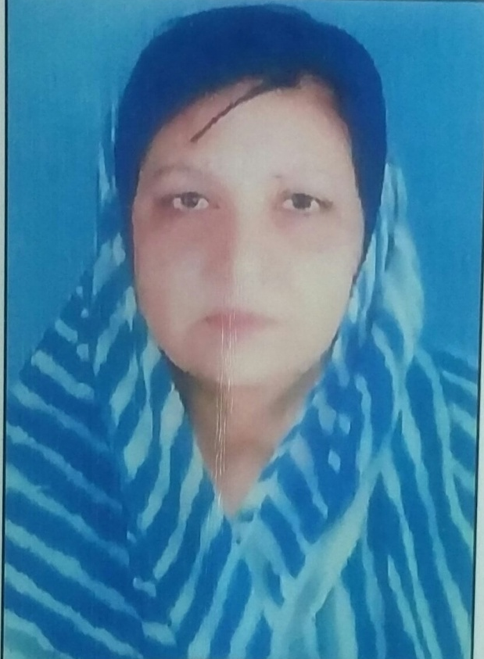
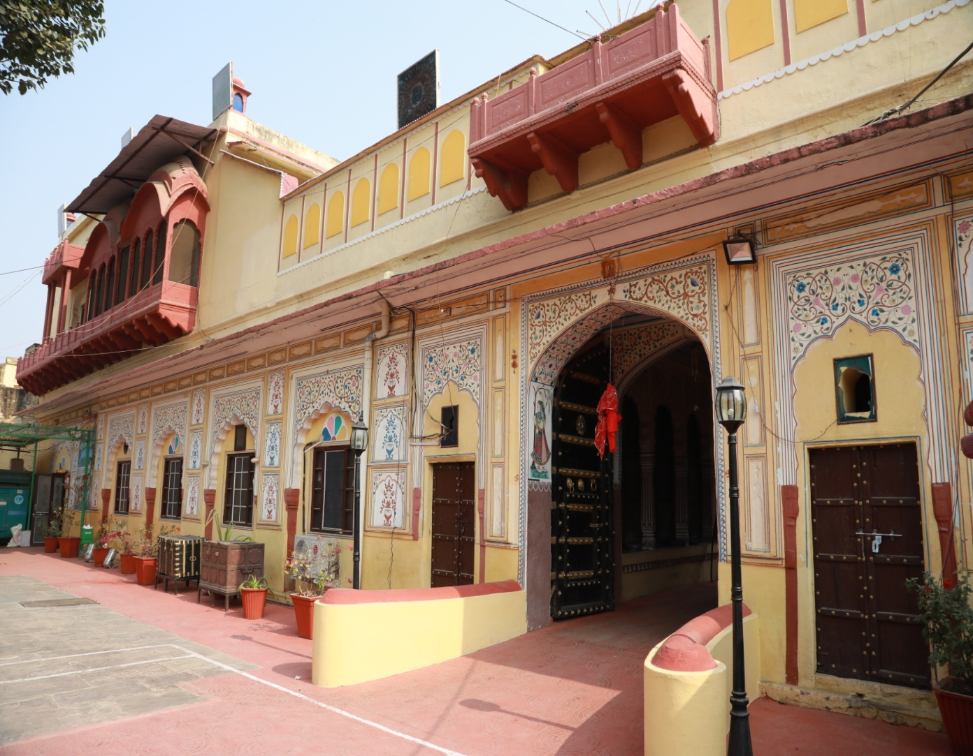
Rajasthan Financial Corporation {RFC}, Jaipur
M/s Hotel Burja Haveli
Smt. Geeta Kumari

Slide 13
Rajasthan Financial Corporation {RFC}, Jaipur
M/s Hotel Burja Haveli
M/s Hotel Burja Haveli is a 240 years old haveli, strongly built, presents an ethnic look with traditional Rajasthani architecture. Smt. Geeta Kumari renovated the haveli and converted it to heritage hotel in the year 2004 with financial assistance from RFC. It is situated on Alwar-Rajgarh road surrounded by a lush green area with a view of Aravali hills. The haveli is internationally reputed. The property is close to a number of popular attractions of Alwar such as Jaisamand Lake, Siliserh Lake Palace and Sariska Tiger Reserve. It is a standard account and is regular in its repayment.

Slide 14
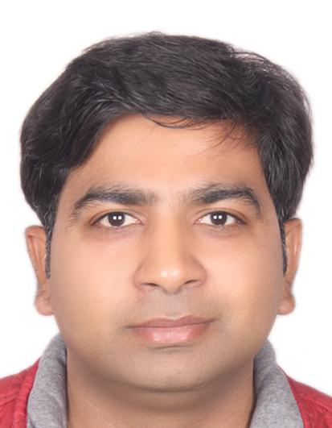
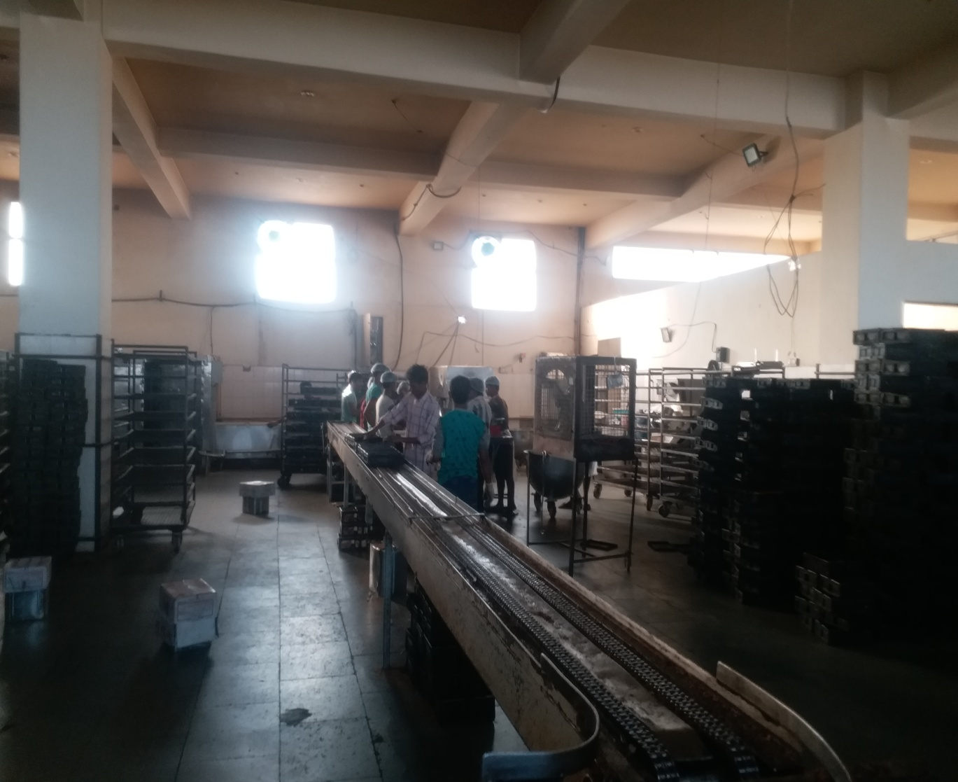
Rajasthan Financial Corporation {RFC}, Jaipur
M/s Hovis Food
Shri Devendra Agarwal

Slide 15
Rajasthan Financial Corporation {RFC}, Jaipur
M/s Hovis Food
Founded in 2005 by Shri Devendra Agarwal with financial assistance from RFC M/s M.P Food Products makes high quality bread, Kulcha Base, Pizza Base, Burger Buns, Fruit Buns, Sweet Buns, Pavs etc. under the brand name Hovis. In 2011 the Group underwent major expansion and started making Herbal Amla Products and Fruit Products. Hovis is one of the leading brands today. It also runs Charitable trust viz Shri Mahadev Prasad Charitable Trust which is involved in many social activities.

Slide 16
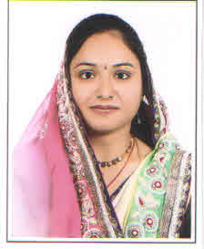
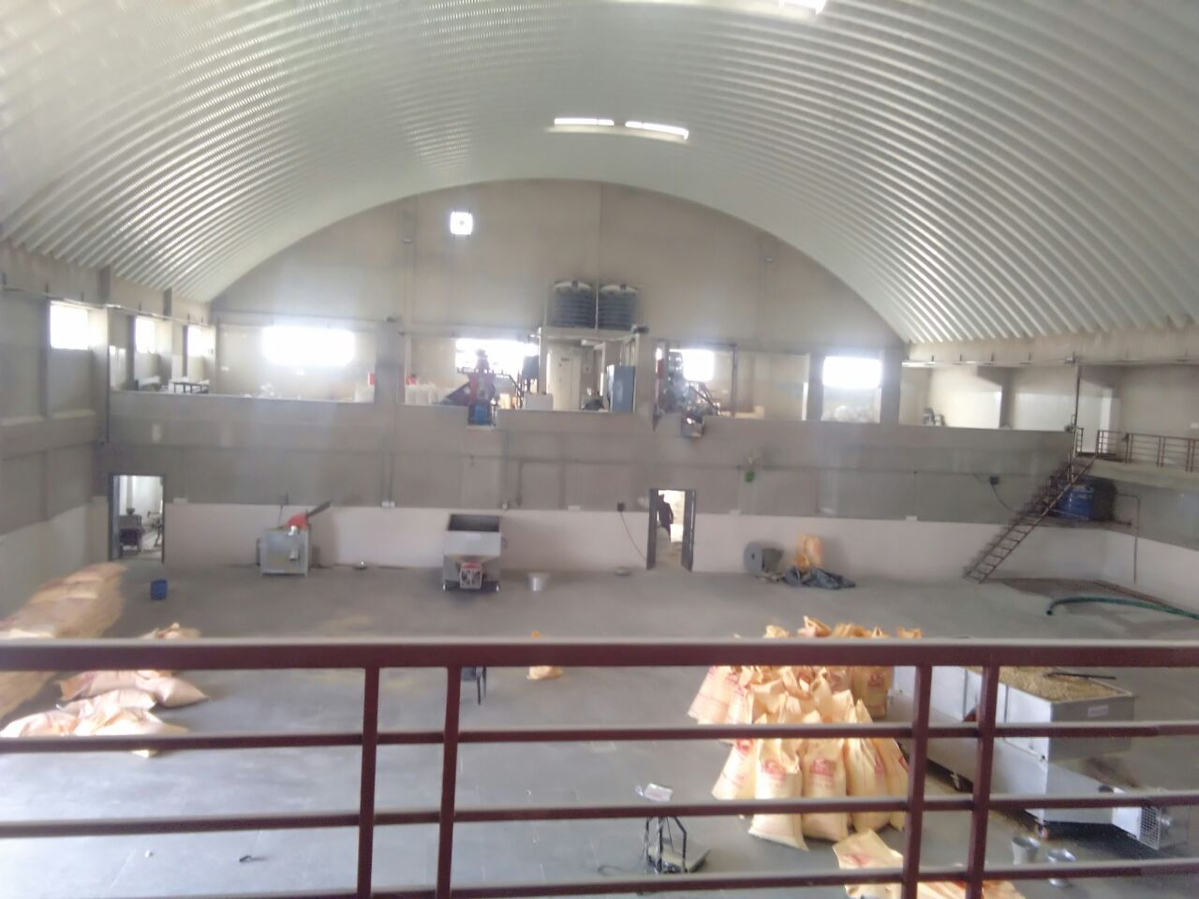
Rajasthan Financial Corporation {RFC}, Jaipur
M/s Vidhisha Food Products
Smt. Shalu Jain

Slide 17
Rajasthan Financial Corporation {RFC}, Jaipur
M/s Vidhisha Food Products
M/s Vidhisha Food Products was established in Alwar as a proprietary concern by Smt. Shalu Jain with financial assistance from RFC. The unit manufactures Soya bean products like Soya Bean Chunks, Soya Bean Mini, Soya Bean Granuals, etc. These are rich source of proteins. The unit provides good quality products at reasonable prices and therefore, has a commendable market share. The production of the unit is about 3 tons per day.

Slide 18
Rajasthan Financial Corporation {RFC}, Jaipur
M/s Construction Aid
M/s Construction Aid was established by Shri Harish Kumar Prajapati with financial assistance from RFC. The company has a good reputation in market and is very prompt in its repayment .

Slide 19
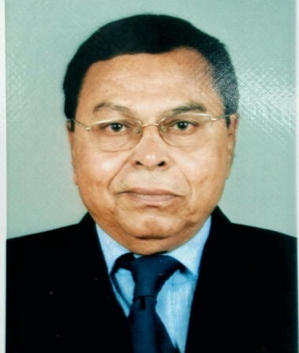
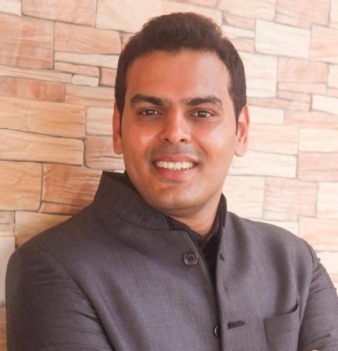
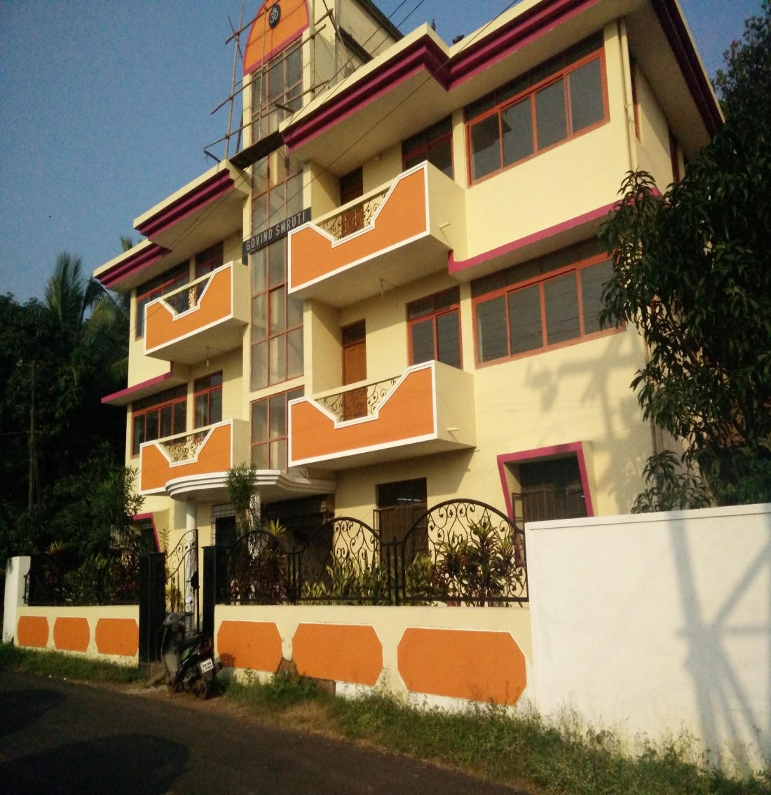
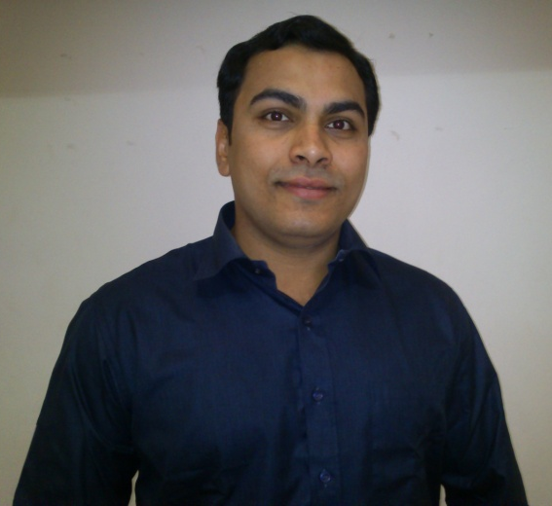
EDC Limited, GOA
M/s Goa Sintered Products Pvt. Ltd.
Shri Anil G. Lotlikar
Shri Kunal Lotlikar
Shri Rahul Lotlikar

Slide 20
EDC Limited, GOA
M/s Goa Sintered Products Pvt. Ltd.
M/s Goa Sintered Products Pvt. Ltd was promoted by Shri Anil G. Lotlikar, Shri Kunal Lotlikar and Shri Rahul Lotlikar in 1980s with financial assistance from EDC Goa. The products manufactured include: Sintered self lubricating Bushes; Gears, Rotors etc. which are used in Home appliances industry, Automobile industries and general engineering industries.
The company’s G.S.P Brand is a market leader and supplies to: M/s. Larsen & Toubro Ltd.; M/s. Crompton Greaves Ltd., etc. and also exports its products to Indonesia / Sharjah etc. The unit employs over 35 employees and achieved a turnover of over Rs.2.50 crore in 2017.

Slide 21
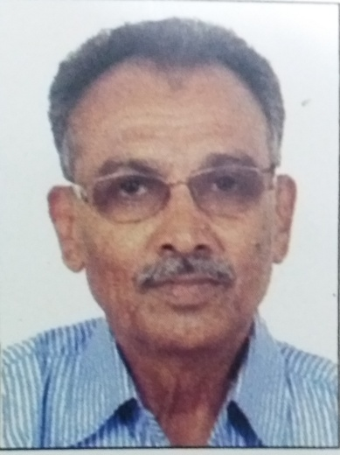
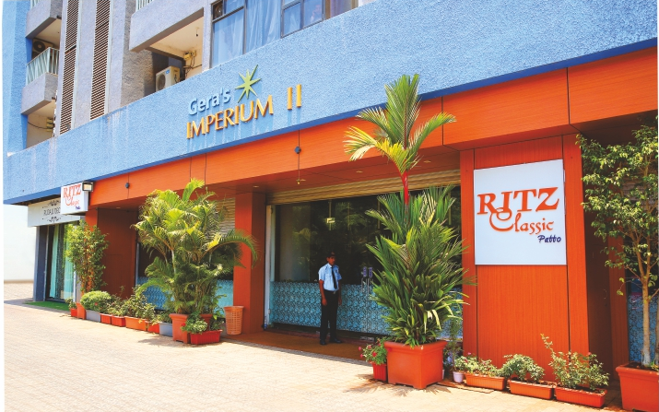
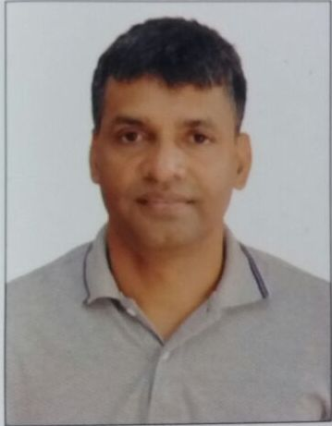
EDC Limited, GOA
M/s Ritz Classic Restaurant And Bar
Shri. Rohidas Dessai
Shri. Rajesh Dessai

Slide 22
EDC Limited, GOA
M/s Ritz Classic Restaurant And Bar
M/s Ritz Classic Restaurant & Bar was started in 1976 by Shri Rohidas Dessai in Panjim. He started a modest restaurant serving traditional food of Goans. His son Shri Rajesh Dessai envisioned a larger restaurant for tourists coming to Goa. He started Ritz Classic, Panjim offering sumptuous Goan food as well as other cuisines. For further expansion Shri Rajesh Desai obtained financial assistance from EDC Goa and now has three more outlets in Goa. Ritz Classic has been the TIMES FOOD AWARDS WINNER for Best Seafood and Best Goan Fish Thali in Goa from 2011 to 2017. The sales revenue has increased from a humble few lakhs to over Rs.12 crores as on March 2017.

Slide 23
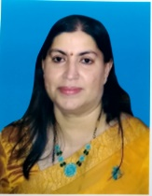
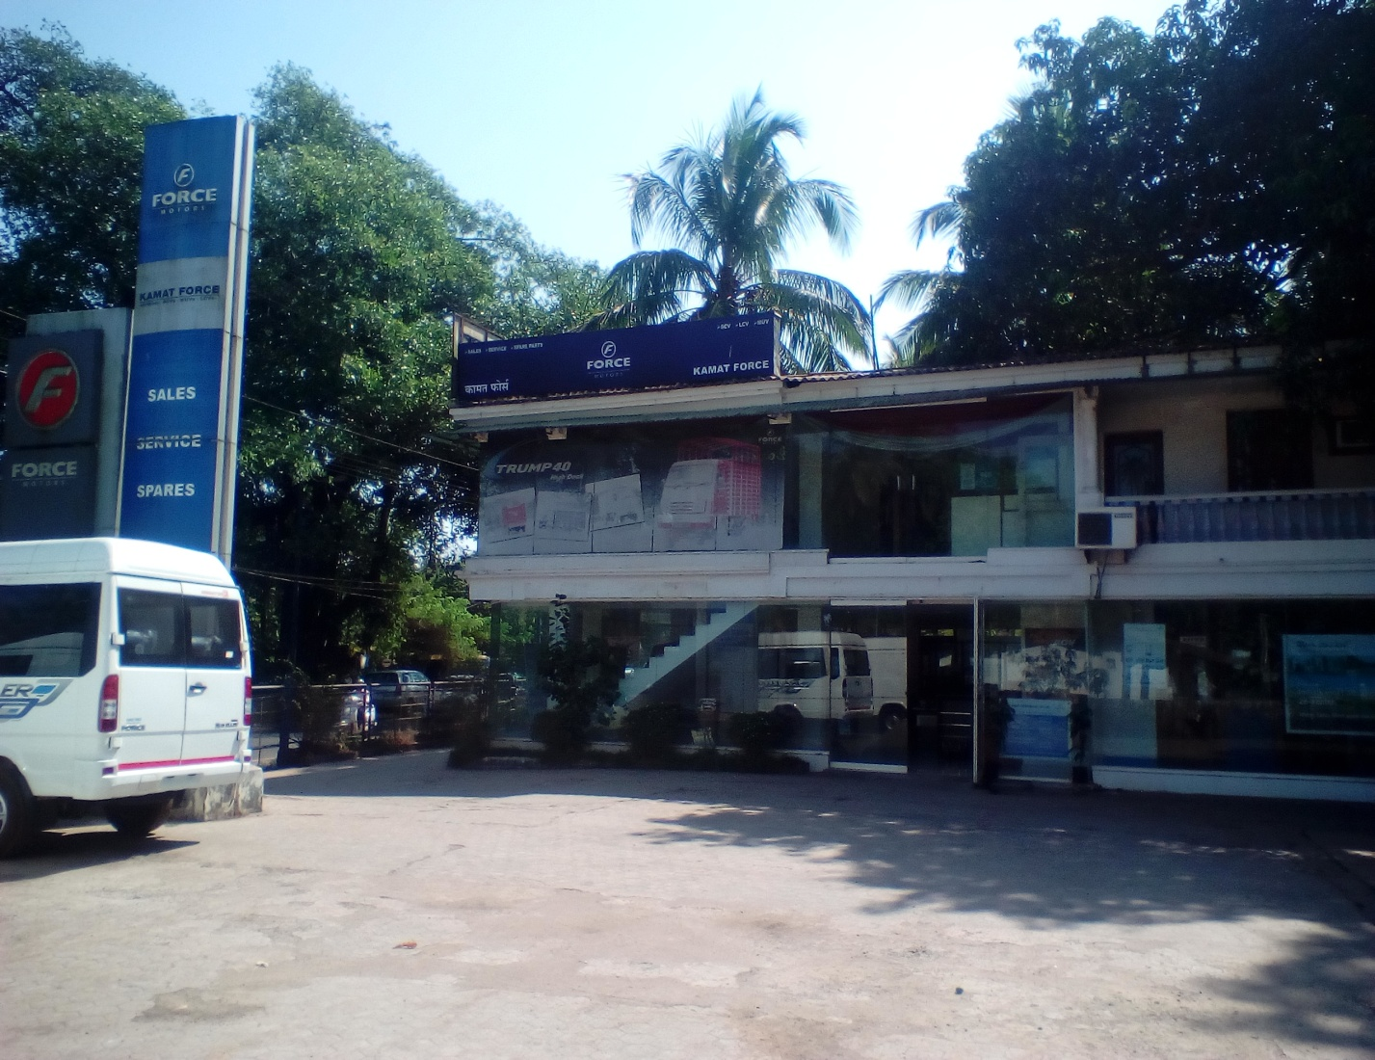
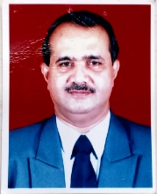
EDC Limited, GOA
M/s Kamat Automobiles Pvt. Ltd.
Smt. Meeta Kamat
Shri Prashant Kamat

Slide 24
EDC Limited, GOA
M/s Kamat Automobiles Pvt. Ltd.
M/s Kamat Automobiles Pvt. Ltd. was promoted by Shri Prashant Kamat and Smt. Meeta Prashant Kamat in the year 2008 with financial assistance from EDC Goa. The company is an authorized dealer for M/s Force Motors Ltd. It also provides services for Kirloskar Marine Diesel Engines used by the Indian Navy and Coast guards. The company has achieved a turnover of Rs.11 crore and provides direct employment to 113 employees.

Slide 25
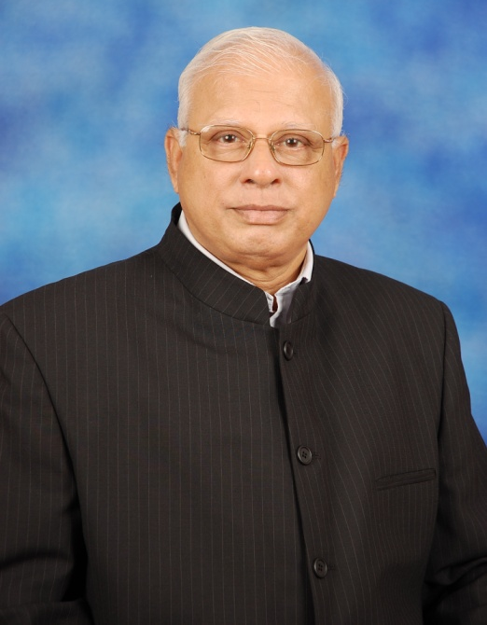
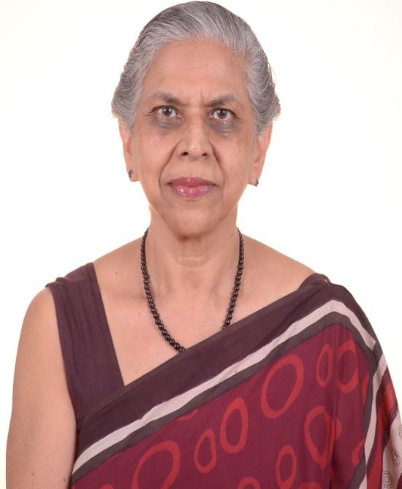
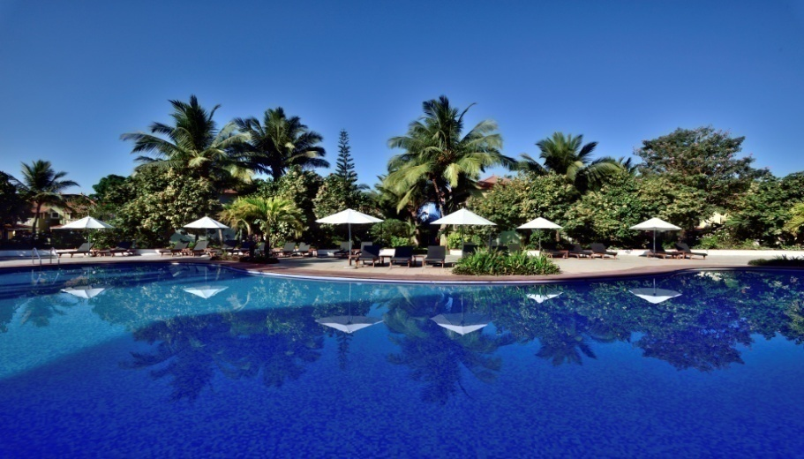
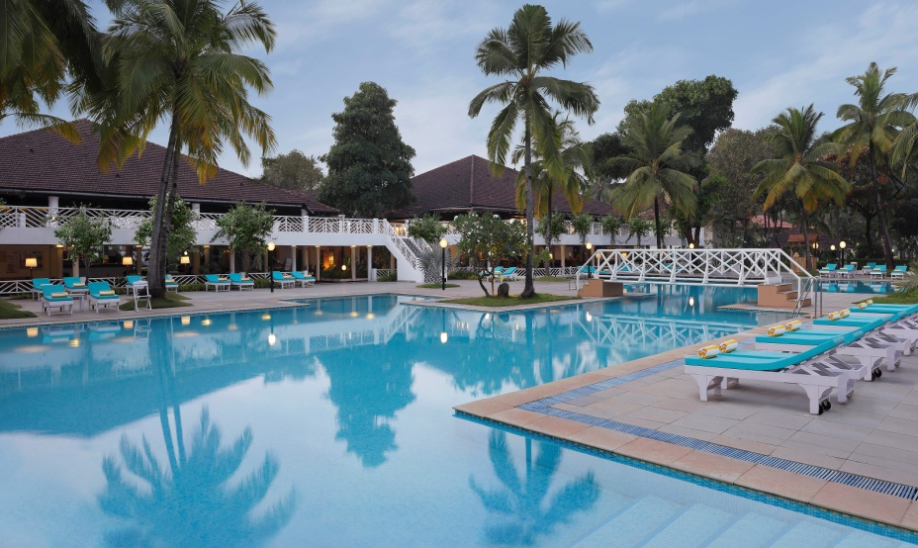
EDC Limited, GOA
M/s Alcon Resort Holdings P. Ltd.
Mr. Victor Albuquerque
Mrs. Sylvia Albuquerque

Slide 26
EDC Limited, GOA
M/s Alcon Resort Holdings P. Ltd.
Promoted by Mr. Victor Albuquerque with financial assistance from EDC Goa, M/s Alcon Resort Holding Pvt. Ltd. Is a reputed hospitality company which owns and operates many hotels in Goa viz..
  Radisson Blu Resort Goa Cavelossim Beach, Goa (5 star deluxe)
  Novotel Goa Dona Sylvia, Cavelossim, Goa (5 star)
  Devaaya Ayurveda & Nature Cure Centre, Divar Island
  Viva Hotel, Margao
Mr. Victor Albuquerque has been the pioneer for many projects in Tourism sector in the State. The other promoters are his wife Mrs. Sylvia Albuquerque and their sons Mr. Vinay Albuquerque & Mr. Varun Albuquerque.
The hotels are professionally managed. The company has achieved a turnover of Rs.70 crore in 2017 and employes almost 700 employees.

Slide 27
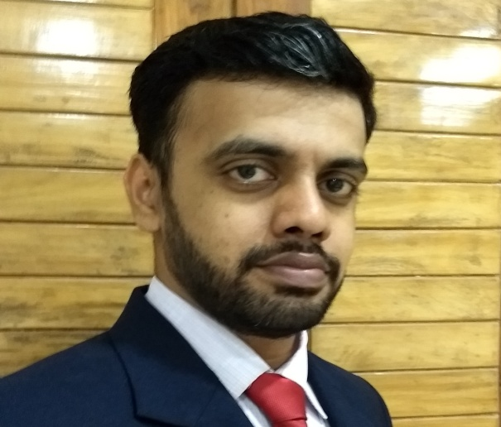
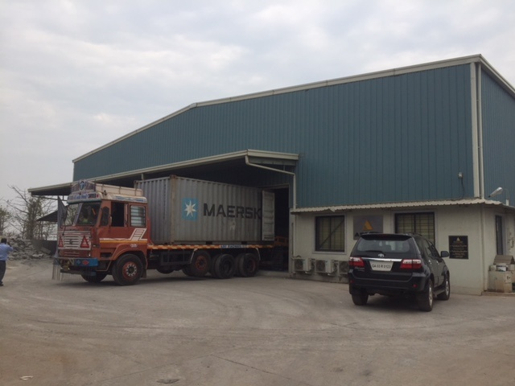
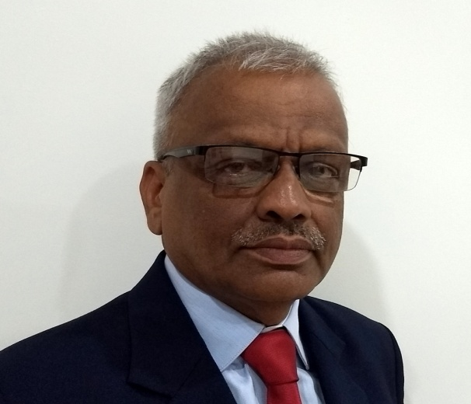
EDC Limited, GOA
M/s Astra Concrete Products
Shri Sushant Parulekar
Shri Shrikant Parulekar

Slide 28
EDC Limited, GOA
M/s Astra Concrete Products
M/s Astra Concrete Products was established with financial assistance from EDC Goa in 1998 by Shri Shrikant Parulekar an engineering graduate. The firm is a manufacturer and exporter of quality pre cast concrete products and supplies its products to metro systems, high rise towers etc. in India and abroad. It exports to ten countries like New Zealand, Japan etc. and more than sixty percent of its revenue is generated by exports. Astra Concrete Products has developed a unique technology to utilize industrial waste products like blast furnace slag in their products thus helping to reduce the harmful impact on the environment. The company's sales crossed Rs.97 million in 2016-17. The firm employs over 148 employees.

Slide 29
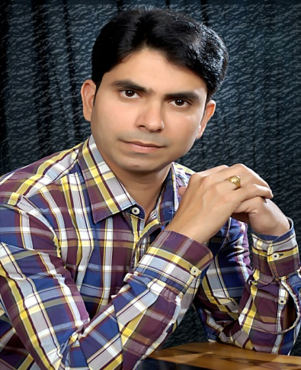
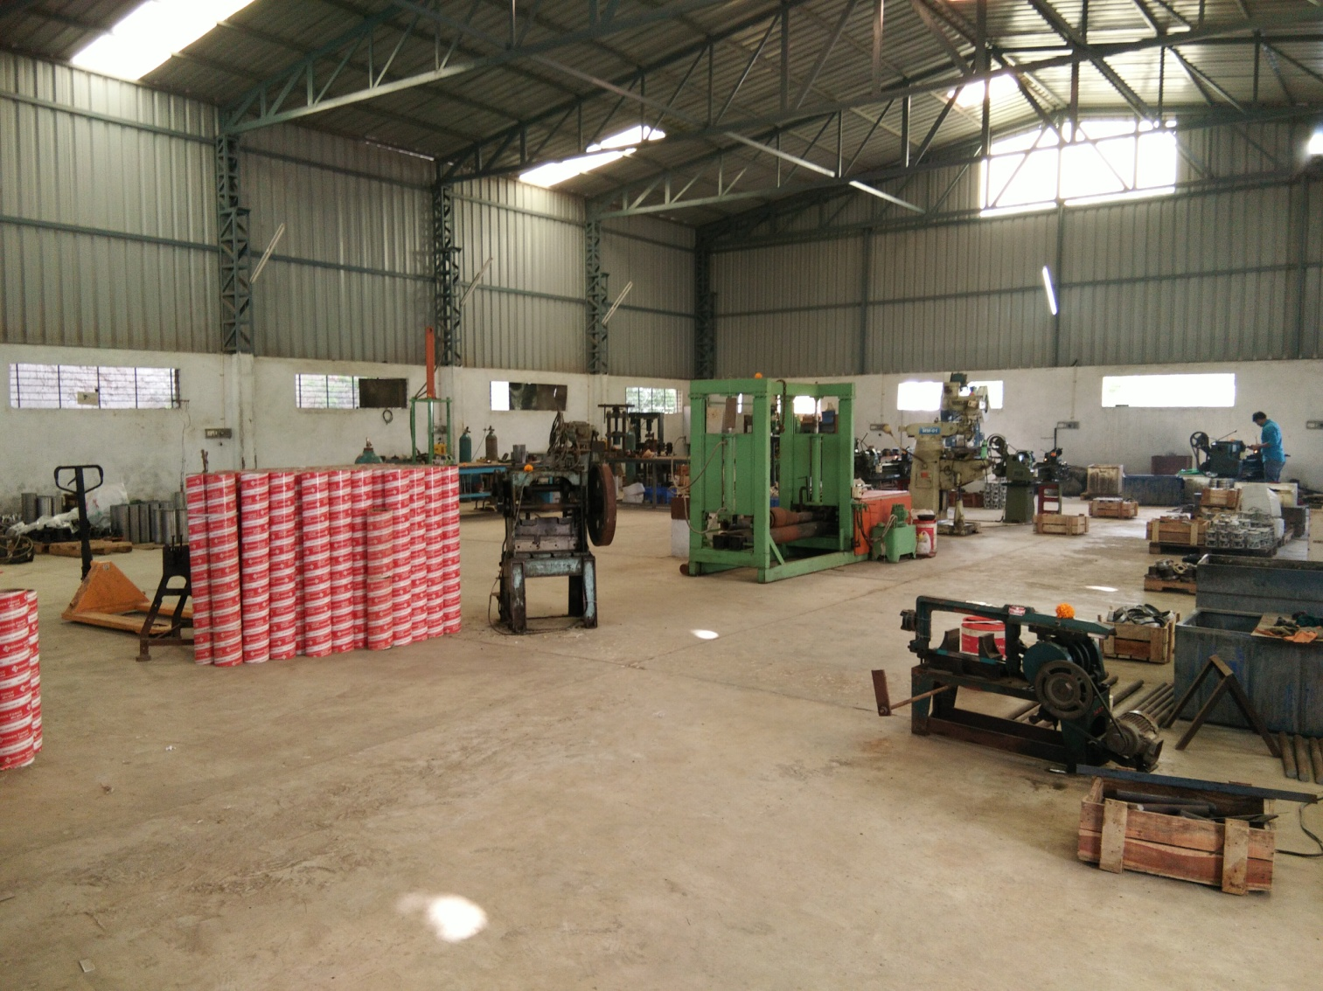
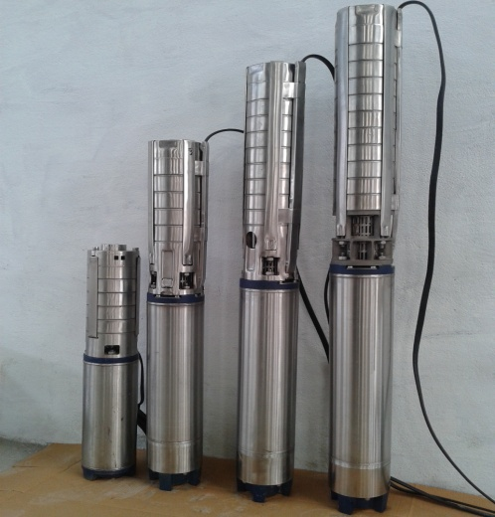
Madhya Pradesh Financial Corp. {MPFC}
Indore
M/s Universal Motors
Shri Manoj Kumar Sharma

Slide 30
Madhya Pradesh Financial Corp. {MPFC}
Indore
M/s Universal Motors
Established by Shri Manoj Kumar Sharma in the year 2010 with financial assistance from MPFC M/s Universal Motors manufactures submersible pumps and electrical motors ranging from 1 HP to 25 HP. Shri Manoj Sharma initially worked in a motor winding workshop for 20 years and developed skills for manufacturing of submersible pumps. Thereafter, he set up his own unit at Pithampur. The unit enjoys a good reputation in the market.

Slide 31
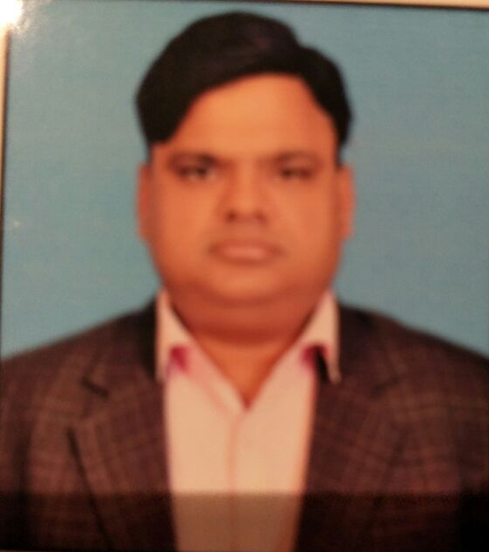
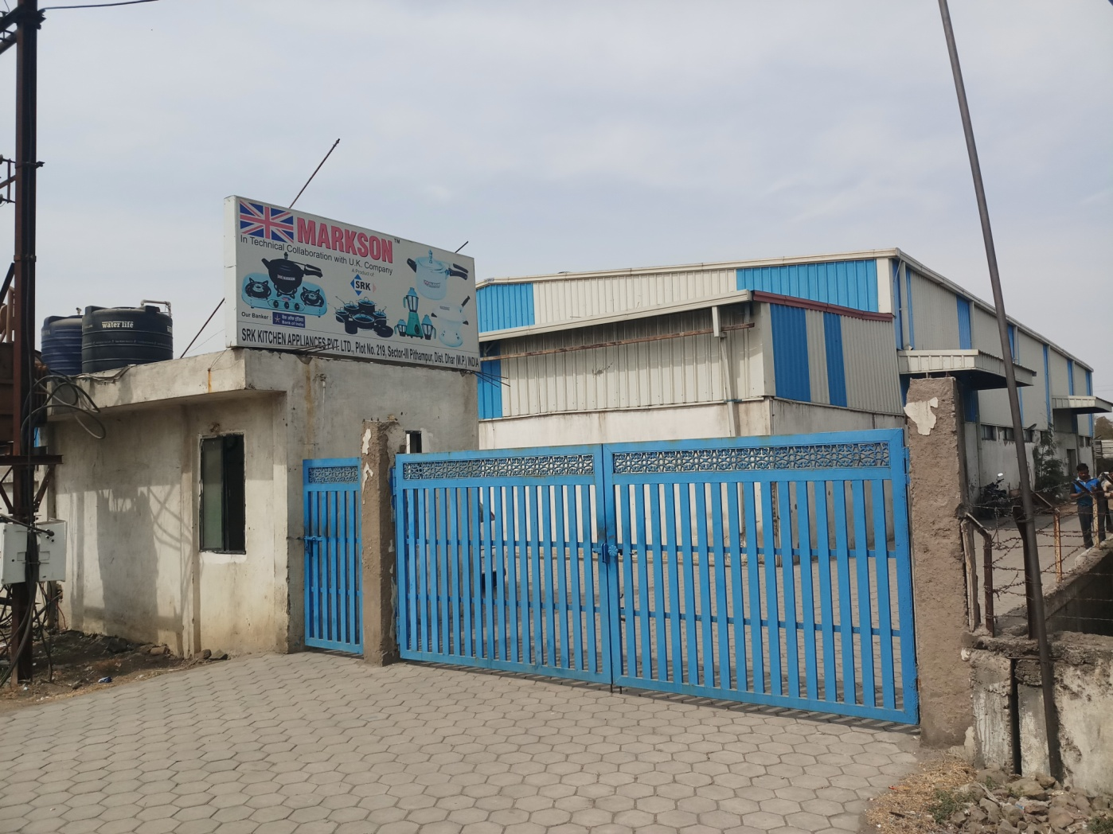
Madhya Pradesh Financial Corp. {MPFC}
Indore
M/s SRK Kitchen Appliances Pvt. Ltd.
Shri Ravi Goyal

Slide 32
Madhya Pradesh Financial Corp. {MPFC}
Indore
M/s SRK Kitchen Appliances Pvt. Ltd.
Established by Shri Ravi Goyal in the year 2014 with financial assistance from MPFC. M/s SRK Kitchen Appliances Pvt. Ltd. is manufacturing more than 18 types of pressure cookers, LPG stoves & home appliances. The firm has a total range of more than 200 products of various capacities and enjoys a very good reputation in the market.

Slide 33
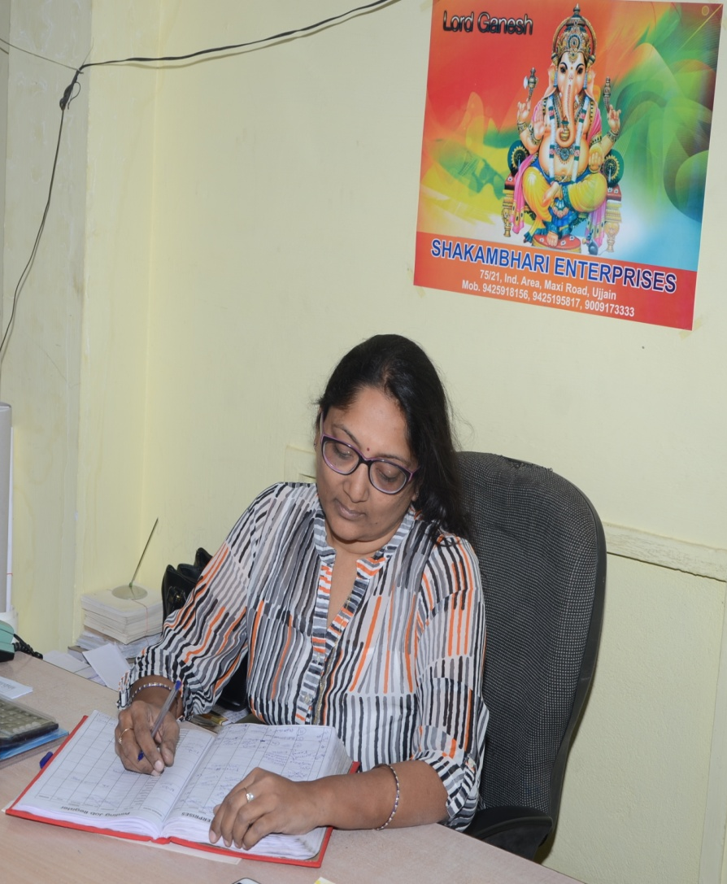
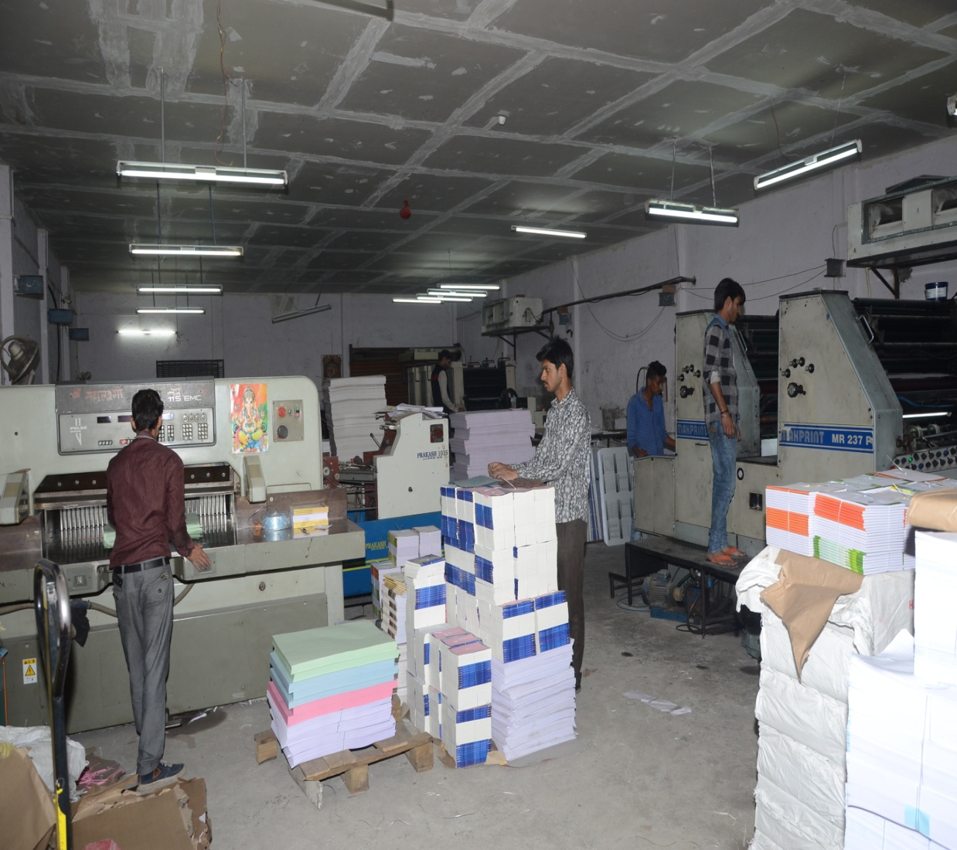
Madhya Pradesh Financial Corp. {MPFC}
Indore
M/s Shakambhari Enterprises
Smt. Vanita Rungta

Slide 34
Madhya Pradesh Financial Corp. {MPFC}
Indore
M/s Shakambhari Enterprises
Established by Smt. Vanita Rungta in the year 2004 with financial assistance from MPFC M/s Shakambhari Enterprises is involved in manufacturing and marketing of exercise note books and publication of academic books of school level. Keeping in view the increasing demand and prospects in the industry, she recently expanded the activities of the firm and set up another big unit in Ujjain with further assistance from MPFC. She is being honoured as the Best Woman Entrepreneur.

Slide 35
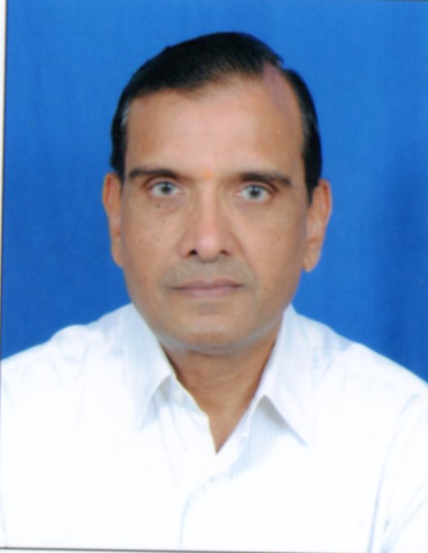
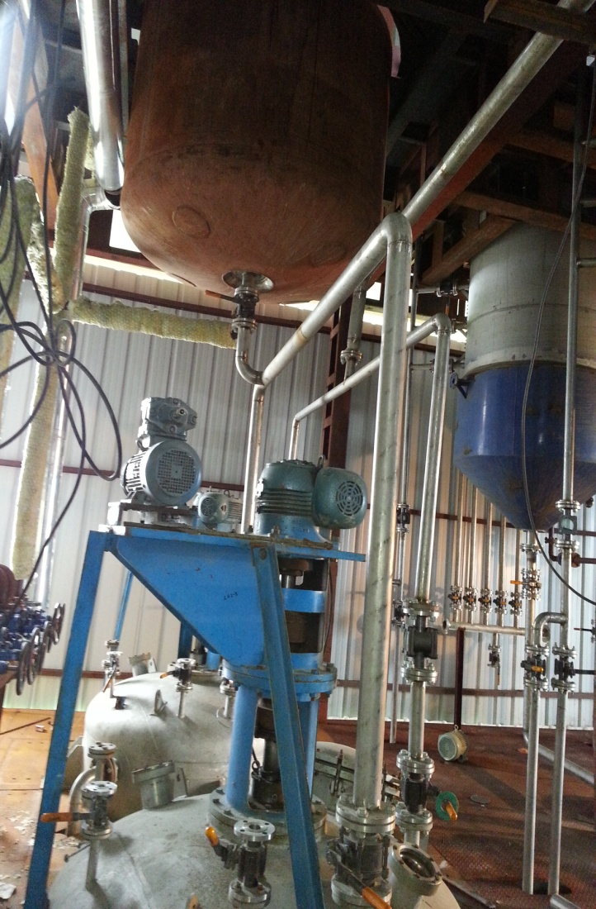
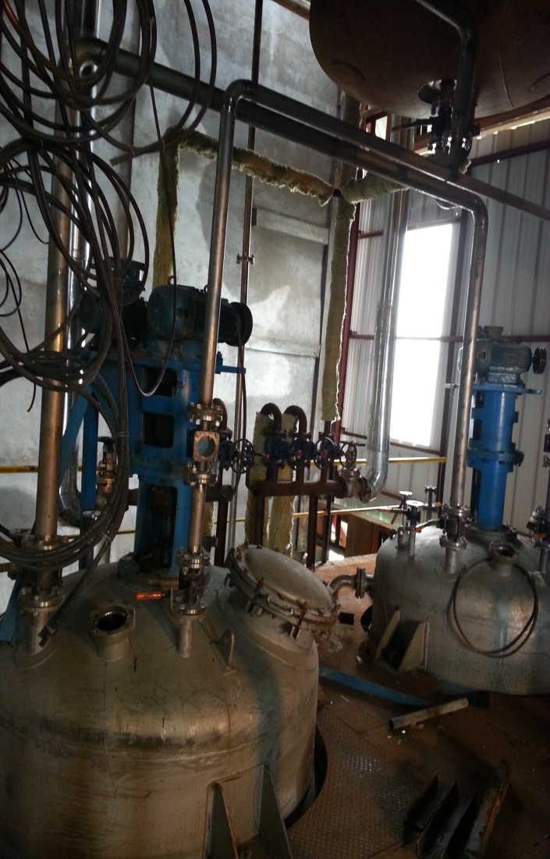
Madhya Pradesh Financial Corp. {MPFC}
Indore
M/s Amitex Engineering Services Pvt. Ltd.
Shri Radheshyam Lahoti

Slide 36
Madhya Pradesh Financial Corp. {MPFC}
Indore
M/s Amitex Engineering Services Pvt. Ltd.
M/s Amitex Engineering Services Pvt. Ltd. is a partnership firm established in 2014 with Financial Assistance from MPFC. The main promoter of the company is Shri Radheshyam Lahoti. The unit is engaged in fabrication and installation of Soya and rice bran extraction plants. Shri Radheyshyam Lahoti is a pioneer in this line and has supplied more than 160 soya plants and rice bran extraction plants all over India and abroad. The annual turnover of the company is Rs. 60 crores. The promoter while setting up soya extraction plants found that Lecithin is obtained in the process of degumming crude soy oil and there is a good scope to process by-product of these plants i.e. lecithin oil for manufacturing of food grade Lecithin Powder and PC-35 and PC-10 (Phosphotidyl Cholines) having wide applications in the field of confectionery, pharmaceuticals, paint industry etc. Accordingly the company decided to implement the project for manufacturing lecithin which is used for applications in human food, animal feed, pharmaceuticals, paints, and other industrial applications.

Slide 37
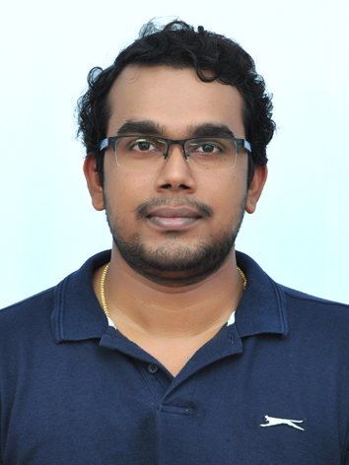
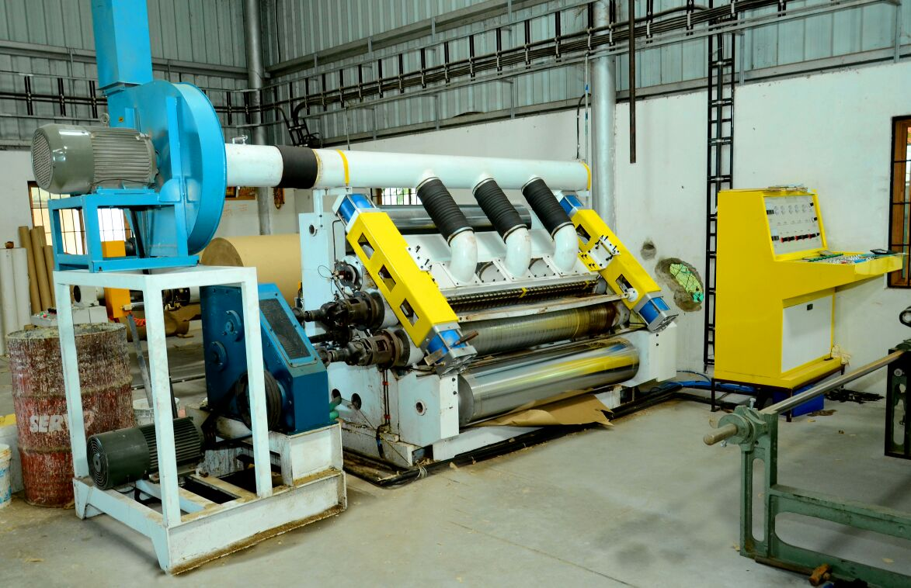
Kerala Financial Corporation {KFC}
Thiruvananthapuram
M/s Kapstone Industries Pvt. Ltd.
Shri Arundas C.H.

Slide 38
Kerala Financial Corporation {KFC}
Thiruvananthapuram
M/s Kapstone Industries Pvt. Ltd.
Founded by Shri Arundas C.H. in the year 2015 with financial assistance from KFC M/s Kapstone Industries Pvt. Ltd., is in the activity of manufacturing corrugated boxes and boards. Kapstone is equipped with state of the art automatic machinery & equipment with a production capacity of 300 Tons per month. Kapstone follows strict quality standards and maintains a safe and hygienic environment. Good quality raw materials are used to ensure high quality of finished product. The unit is also equipped with a laboratory with modern testing machines.

Slide 39
Kerala Financial Corporation {KFC}
Thiruvananthapuram
M/s Aeka Biochemical Pvt. Ltd.
M/s Aeka Biochemicals Pvt. Ltd. was founded by Ms. Aardra Chandra Mouli with financial assistance from KFC. The unit undertakes research into and manufacture of biotechnological, biochemical & enzymatic products, chemical products or extracts of biological origin, and environmental solutions, that have application in research, agriculture, environmental remediation and green technology. The first product range from Aeka is a series of microbial plant growth promoters for organic and chemical-free agriculture, for all scales, from house gardens to plantations.
This lab has been granted the Green Category license under the Kerala State Pollution Control Board. The facility depends on solar power as its primary power source.

Slide 40
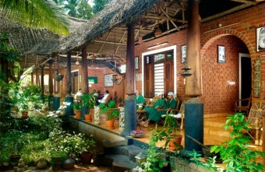
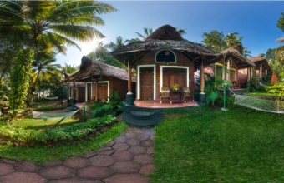
Kerala Financial Corporation {KFC}
Thiruvananthapuram
M/s Somatheeram Beach Resort

Slide 41
Kerala Financial Corporation {KFC}
Thiruvananthapuram
M/s Somatheeram Beach Resort
With the objective of combining Ayurveda and Tourism, Shri Baby Mathew founded the Somatheeram Research Institute & Ayurveda Hospital in the year 1985. It is the world’s first ever Ayurvedic Hospital in a Resort Ambience and provides holistic treatment which includes yoga and meditation. The luxurious accommodation facilities at Somatheeram are built with a touch of Kerala tradition. Cultural performances provide a good entertainment to the visitors.
The resort has won many national, international and State awards for excellence in Ayurvedic Treatments. It has been classified as a Heritage Ayurveda Resort and is an eco friendly venture .

Slide 42
Kerala Financial Corporation {KFC}
Thiruvananthapuram
M/s Hailstone Innovations
M/s Hailstone Innovations was established by Shri R. J. Williams with financial assistance from KFC. The unit enjoys a good reputation in the market and is prompt in its repayment.

Slide 43
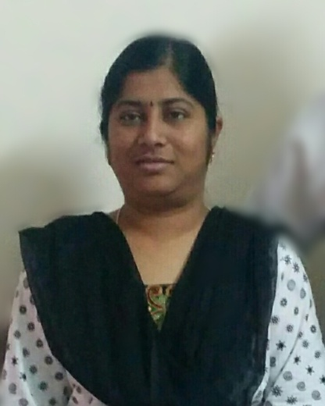


Tamilnadu Industrial Investment Corporation Limited {TIIC}, Chennai
M/s E Bags
Smt. V. Padmapriya
Smt. S. Nithya

Slide 44
Tamilnadu Industrial Investment Corporation Limited {TIIC}, Chennai
M/s E Bags
Smt. V. Padmapriya and Smt. S. Nithya promoted M/s E Bags with financial assistance from TIIC to manufacture shopping bags, commercial bags and other bag items by using Non-woven fabrics. They are first generation entrepreneurs and were first given assistance under the NEEDS scheme of TIIC. The unit has achieved a turnover of nearly Rs.10 crores per annum. Their future plans include export of their products.

Slide 45



Tamilnadu Industrial Investment Corporation Limited {TIIC}, Chennai
M/s R K Metal Roofings Pvt. Ltd.
Shri K. Archunan

Slide 46
Tamilnadu Industrial Investment Corporation Limited {TIIC}, Chennai
M/s R K Metal Roofings Pvt. Ltd.
Founded by Shri K. Archunan with financial assistance from TIIC M/s RK Metal Roofings Pvt. Ltd. is involved in the activity of Metal Pressing Work – Galvlume Sheet Forming. From a humble turnover of Rs.3.00 lakhs in the year 2004 the unit has achieved a turnover of Rs.35.00 Crores in the year 2017. The unit has been conferred with ISO 9001:2005 certification. It uses CNC controlled technology with full Automation and has been awarded “STAR PERFORMER AWARD” for South India continuously for the past 3 years for accomplishing the Target of more than 6000 MT per annum. Its further plans include Manufacture of Square Steel Tubes used for Shed Fabrication.

Slide 47


Tamilnadu Industrial Investment Corporation Limited {TIIC}, Chennai
M/s Copral Insulated Conductors Pvt. Ltd.
Shri S. R. Jeyaprakash

Slide 48
Tamilnadu Industrial Investment Corporation Limited {TIIC}, Chennai
M/s Copral Insulated Conductors Pvt. Ltd.
Established by Shri S. R. Jeyaprakash with financial assistance from TIIC M/s Copral Insulated Conductors Pvt. Ltd. is engaged in the activity of manufacturing Aluminium Conductors/PVC Cables /Electrical Machinery Apparatus & Alliances. M/s CIC Pvt. Ltd. has been conferred with ISO 9001:2008; ISO-14001:2004 and OHSAS “ISO 18001:2007 certification. The unit exports 3.26% of its total turnover. It has achieved a commendable growth of 63.53% over the last three years and has achieved a revenue of Rs.167 crore. It has received a certificate of compliance in respect of Basic Standard used to Investigate Products in this category; is an RDSO Approved Company and UL Certified Company. Its CRISIL Rating is SME2. The company has set a performance target of Rs.200.00 crores in the year ending 31.03.2018.

Slide 49



Karnataka State Financial Corporation {KSFC}, Bangalore
M/s Supreem Pharmaceuticals Mysore P. Ltd.
Shri Sadanand Nagaraja Rao

Slide 50
Karnataka State Financial Corporation {KSFC}, Bangalore
M/s Supreem Pharmaceuticals Mysore P. Ltd.
M/s Supreem Pharmaceuticals Mysore Pvt. Ltd. was established in 1997 by Shri Sadanand Nagaraja Rao with financial assistance from KSFC. The unit is a leading manufacturer of a wide range of bulk tablised/coated vitamins, tasteless minerals, herbal extracts and formulations, food supplements & API's. It exports to USA, Canada, Germany, France etc. and has achieved a turnover of Rs.345 lakhs.

Slide 51


Karnataka State Financial Corporation {KSFC}, Bangalore
M/s Sakthi Accumulators Pvt.Ltd

Slide 52
Karnataka State Financial Corporation {KSFC}, Bangalore
M/s Sakthi Accumulators Pvt.Ltd
M/s Sakthi Accumulators Pvt. Ltd. was founded in 1994 by Shri Kandasamy, Shri K. Nagaraj and Shri R. Mohanasundaram with financial assistance from KSFC. The unit manufactures UPS & solar batteries & electrical products. The company has built good reputation in the markets for its brand 'SAKTHI'. It is accredited as Grade 'A' supplier with BEL, ISRO, NTPC, ADA and registered with DGS&D supplier.

Slide 53





Karnataka State Financial Corporation {KSFC}, Bangalore
M/s Mallur Flora & Hospitality Pvt. Ltd.
Shri Munilakkappa
Managing Director
Shri Aakaash.S.Raju, CEO
Smt. S.M.Rathnamma Director
Smt.Sunitha Raju, Director

Slide 54
Karnataka State Financial Corporation {KSFC}, Bangalore
M/s Mallur Flora & Hospitality Pvt. Ltd.
M/s Mallur Flora & Hospitality Pvt. Ltd. was established by Shri Munilakkappa Appiga; Smt. Rathnamma Sultanpet Munilakkappa; Shri. Aakaash Sultanpet Raju and Smt. Sunita Raju as a private limited company in the year 1998 with financial assistance from KSFC. The unit has developed ayurvedic medicines for curing various life style diseases and has obtained licence from the Directorate of AYUSH dept. for manufacture of 6 medicines. The unit had released its products at New-Delhi during 2016 through AYUSH Ministry.

Slide 55



Karnataka State Financial Corporation {KSFC}, Bangalore
M/s Girish Paper Packaging (P) Ltd.
Sri Anil Kumar Budihal

Slide 56
Karnataka State Financial Corporation {KSFC}, Bangalore
M/s Girish Paper Packaging (P) Ltd.
M/s Girish Paper Packaging (P) Ltd. was established as a Private Limited Company by Shri Mallesh Budihal in the year 1990 with financial assistance of Rs.2.50 crore from KSFC. The unit is engaged in Printing & Packaging with latest 4 colour printing machinery. It has achieved a commendable turnover of Rs.6.54 crore. Their major clientele include Moksha Agabathi, Ashok Trading, Shalimar Agarbathi etc.

Slide 57


Karnataka State Financial Corporation {KSFC}, Bangalore
M/s Shri Krishna Pipe Industries
Shri Bhaskar Nayak

Slide 58
Karnataka State Financial Corporation {KSFC}, Bangalore
M/s Shri Krishna Pipe Industries
M/s Shri Krishna Pipe Industries was established by Shri Bhaskar Nayak and Smt. Bharathi B. Nayak as a partnership firm in the year 1997 with financial assistance of Rs.3. crore from KSFC. The unit manufactures PVC Pipes and is meeting the requirements of local customers under their popular brand name "Sri Krishna", "Sri Ram". It has achieved a turnover of Rs.8.73 crore.

Slide 59

Karnataka State Financial Corporation {KSFC}, Bangalore
M/s Karnataka OEM & Spares Pvt. Ltd.
Shri B. Saikumar & Shri V.R. Gourishankar

Slide 60
Karnataka State Financial Corporation {KSFC}, Bangalore
M/s Karnataka OEM & Spares Pvt. Ltd.
M/s Karnataka OEM & Spares Pvt. Ltd. was founded by Shri B. Saikumar; Ms. Preeti Saikumar and Shri V.R. Gourishankar in the year 2014 with financial assistance from KSFC. The unit manufactures fine fasteners and is catering to all Metros. They export to Germany, France & Thailand. The firm has diversified into the activity of power generation from windmills.

Slide 61

Karnataka State Financial Corporation {KSFC}, Bangalore
M/s Hotel Shashinag Residency

Slide 62
Karnataka State Financial Corporation {KSFC}, Bangalore
M/s Hotel Shashinag Residency
M/s Hotel Shashinag Residency was established by Smt. Parvathi Annappanavar in the year 2003 with financial assistance of Rs.6.07 crore from KSFC. The hotel is one of the best hotels in Vijayapura District.

Slide 63

Karnataka State Financial Corporation {KSFC}, Bangalore
M/s Hotel Lumbini

Slide 64
Karnataka State Financial Corporation {KSFC}, Bangalore
M/s Hotel Lumbini
M/s Hotel Lumbini in Kalaburgi was started by Smt. Vanitha Devi in the year 2009. It is a reputed hospitality property. The hotel is situated in the heart of Gulbarga City, thus offering an ideal location for finest experiences that Gulbarga has to offer establishing itself as the best hotel in the city. It welcomes royalty and celebrities as its clients.

Slide 65
Andhra Pradesh State Financial Corporation {APSFC}, Vijayawada
M/s A One Ispat Pvt. Ltd.
M/s A One Ispat Pvt. Ltd. established by Shri Sanjay Kumar Jallan with financial assistance from APSFC. The unit enjoys a good reputation in the market and is prompt in its repayment.

Slide 66


Andhra Pradesh State Financial Corporation {APSFC}, Vijayawada
M/s Vedha Entech India Pvt. Ltd.
Shri G. Dharmarao

Slide 67
Andhra Pradesh State Financial Corporation {APSFC}, Vijayawada
M/s Vedha Entech India Pvt. Ltd.
M/s Vedha Entech India Pvt. Ltd. established by Shri G. Dharmarao with financial assistance from APSFC. The unit enjoys a good reputation in the market and is prompt in its repayment.

Slide 68

Andhra Pradesh State Financial Corporation {APSFC}, Vijayawada
M/s Deccan Ferro Alloys (P) Ltd.
Shri P.S.R. Raju

Slide 69
Andhra Pradesh State Financial Corporation {APSFC}, Vijayawada
M/s Deccan Ferro Alloys (P) Ltd.
M/s Deccan Ferro Alloys Pvt. Ltd. was established by Shri P.S.R. Raju near Visakhapatnam (A.P), with financial assistance from APSFC to manufacture various Manganese Alloys like Silico Manganese and High carbon Ferro Manganese. The unit is presently manufacturing 30,000 TPA of Silico Manganese,- selling in India and exporting to Korea, Italy, Netherlands etc. The unit has obtained ISO 9001-2008 Certification from TUV Rheinland, West Germany. Shri Raju, has won “Udyogratan Award”, “Rajiv Gandhi Excellence Award” and best Enterprenuer awards from Government of Andhra Pradesh.
The company is committed to high quality products alongwith looking after worker safety and adhering to environment norms.

Slide 70

Andhra Pradesh State Financial Corporation {APSFC}, Vijayawada
M/s Coastal Fats & Oils Pvt. Ltd.

Slide 71
Andhra Pradesh State Financial Corporation {APSFC}, Vijayawada
M/s Coastal Fats & Oils Pvt. Ltd.
M/s Coastal Fats & Oils Pvt. Ltd. was established by Shri Nalam Charan Kumar with financial assistance from APSFC. The unit enjoys a good reputation in the market and is prompt in its repayment.

Slide 72


Andhra Pradesh State Financial Corporation {APSFC}, Vijayawada
M/s Sree Arka Greentech Pvt. Ltd.
Smt. Machina Shyamala
Shri Machina Gnagadhar

Slide 73
Andhra Pradesh State Financial Corporation {APSFC}, Vijayawada
M/s Sree Arka Greentech Pvt. Ltd.
Smt. Machina Shyamala established M/s Sree Arka Greentech Pvt. Ltd. with financial assistance from APSFC and started commercial production in 2016. Shri Machina Gnagadhar is the other Director. The unit is involved in the activity of manufacturing Solar Photo Voltaic Modules. The track record of repayment of the unit to the Corporation is Excellent.

Slide 74

Andhra Pradesh State Financial Corporation {APSFC}, Vijayawada
M/s Deekshitha Packagings
Smt. Pandu Veeralakshmi

Slide 75
Andhra Pradesh State Financial Corporation {APSFC}, Vijayawada
M/s Deekshitha Packagings
M/s Deekshitha Packagings was promoted by Smt. Pandu Veeralakshmi with financial assistance from APSFC to manufacture Corrugated Boxes. The unit was fully implemented during 2012. The promoters have established a very good track record of repayment of loan to the Corporation.

Slide 76


West Bengal Financial Corporation {WBFC}, Kolkata
M/s Hotel Dreamland Pvt. Ltd.
Sri Avrajyoti Roy

Slide 77
West Bengal Financial Corporation {WBFC}, Kolkata
M/s Hotel Dreamland Pvt. Ltd.
Sri Avrajyoti Roy established M/s Hotel Dreamland Pvt. Ltd. at Haldia in the year 1999 with the financial assistance from WBFC. The company then set up 4 more hotels all over West Bengal with further financial assistance from WBFC. All the hotels are running satisfactorily. The company is regular in its repayment to the corporation.

Slide 78



West Bengal Financial Corporation {WBFC}, Kolkata
M/s Reliable Hatcheries Pvt. Ltd.
Smt. Sarmistha Roy

Slide 79
West Bengal Financial Corporation {WBFC}, Kolkata
M/s Reliable Hatcheries Pvt. Ltd.
M/s Reliable Hatcheries Pvt. Ltd. (RHPL) was established in the year 2011 with financial assistance from WBFC by Smt. Sarmistha Roy, Ms. Meenakshi Roy, Ms. Shima Roy and Ms. Manisha Goel who set up 20 hatchery units. The unit has now doubled its production capacity to cope-up with the growing demand. In 2016 the Company diversified to set up a Feed plant in Maynaguri with an additional loan from the Corporation. It has achieved a turnover of about Rs.20 crores.

Slide 80

PIPDIC, Pondicherry
M/s G.K.M. New Pharma
Smt. R. Shyamala

Slide 81
PIPDIC, Pondicherry
M/s G.K.M. New Pharma
Smt. R. Shyamala founded M/s G.K.M. New Pharma with financial assistance from PIPDIC. The unit has a good reputation in market and is very prompt in its repayment .

Slide 82



PIPDIC, Pondicherry
M/s Fine Automotive & Industrial Radiators Pvt. Ltd.
Shri Anil Menon

Slide 83
PIPDIC, Pondicherry
M/s Fine Automotive & Industrial Radiators Pvt. Ltd.
Shri Anil Menon founded M/s Fine Automotive & Industrial Radiators Pvt. Ltd. with financial assistance from PIPDIC. The unit has a good reputation in market. The unit is very prompt in its repayment .

Slide 84


PIPDIC, Pondicherry
M/s Le Bracs
Shri M. Nandakumar

Slide 85
PIPDIC, Pondicherry
M/s Le Bracs
Shri M. Nandakumar promoted M/s Le Bracs Rubber which commenced manufacturing activities in 1989 at their factory at Puducherry, India. The facilities are integrated for the fabrication and rubber lining of Pipes and Fittings, Tanks & Vessels. The unit also executes ‘On Site' lining of equipment’s which is too large to be transported. Le Bracs Rubber is the only Rubber lining Company in India with a State-of-Art Extruded Machine manufacturing rubber sheet of thickness from 2mm to 10 mm. These can be used in anti- corrosive and anti-abrasive application. The unit has been given IS0 9001:2015, IS0 14001:2015, and IS0 18001:2007 certification. The Management is committed to product quality and adhering to Environmental norms and Safety.

Slide 86


Thanks

